Slide 1
Introduction to Canvas - Teaching
Thursday 2nd July 2020 10.00-11.30

Slide 2
Muting your mic & system audio
If you loose your connection or leave the Zoom meeting,
follow the link in the Canvas module to rejoin

Slide 3
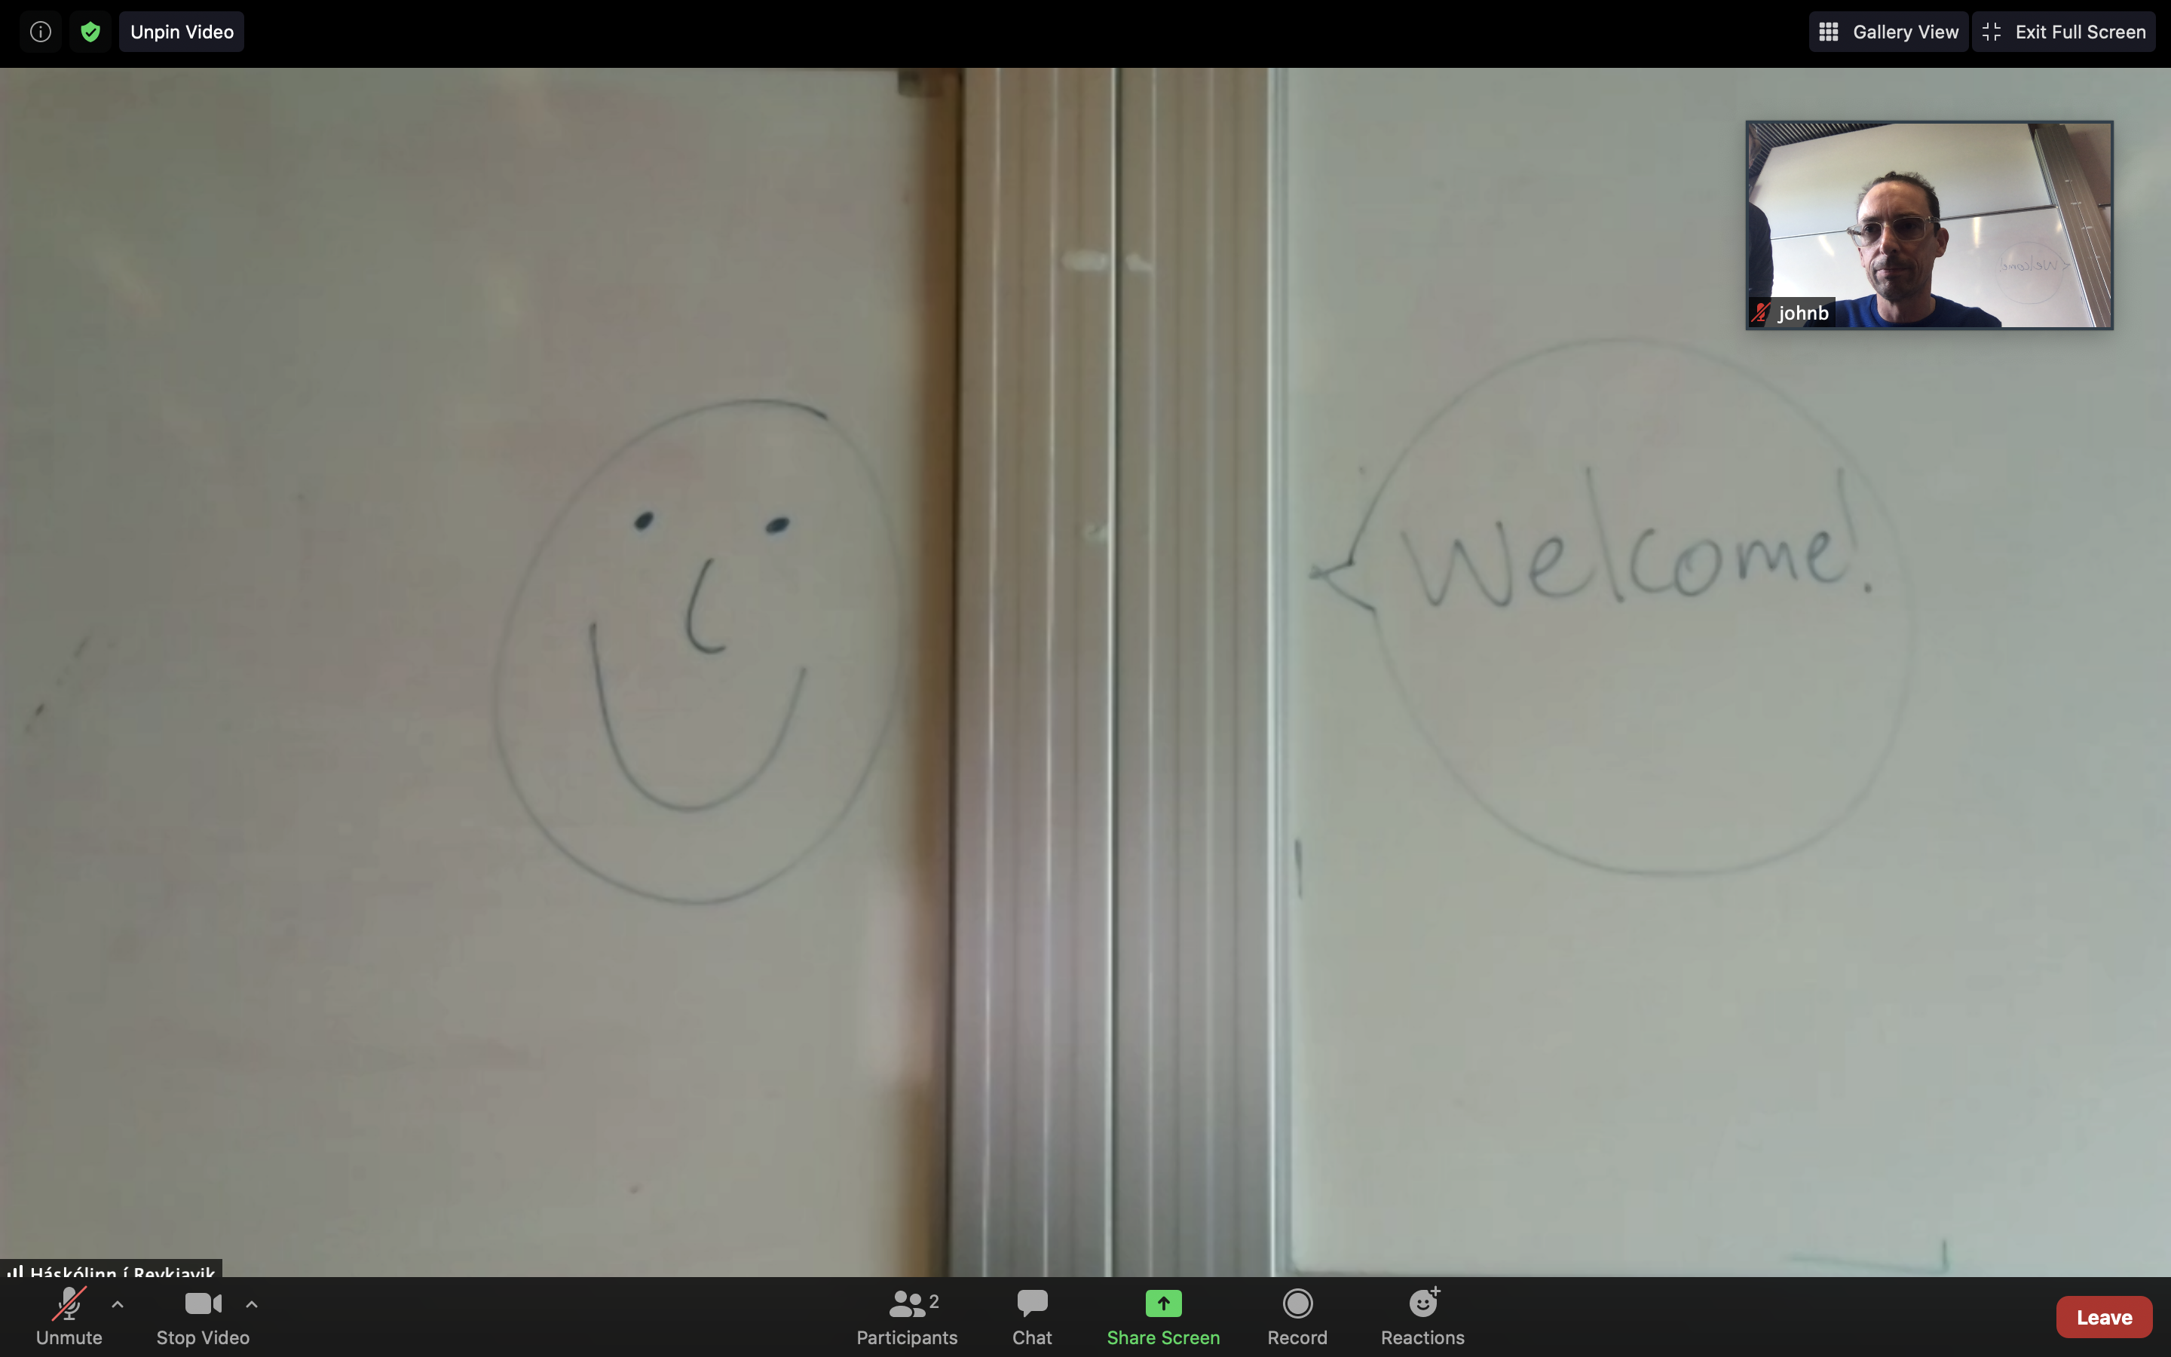
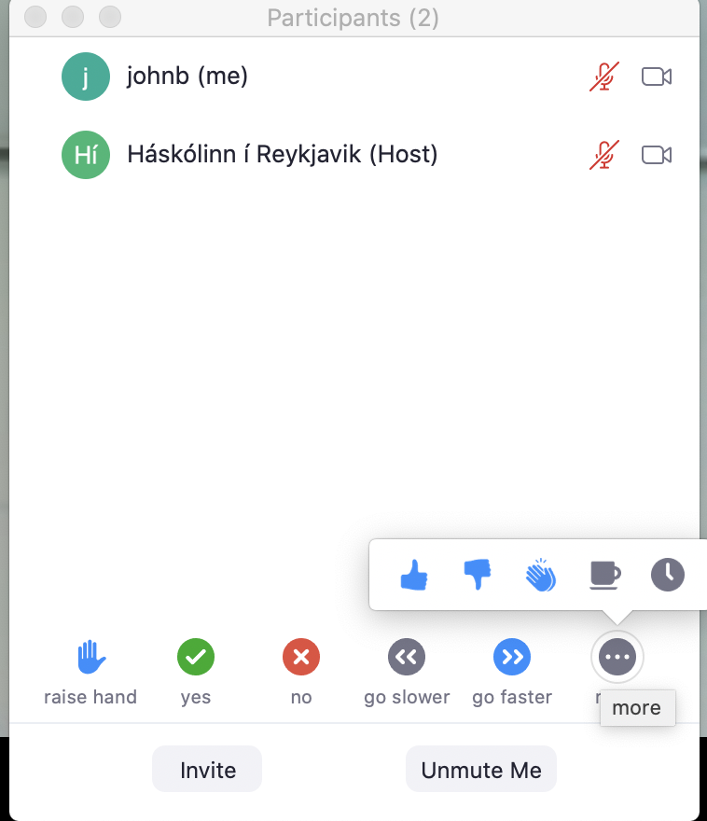
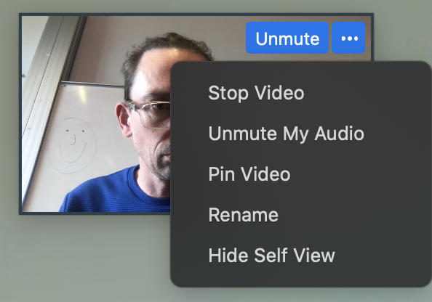
DEMO

Slide 4
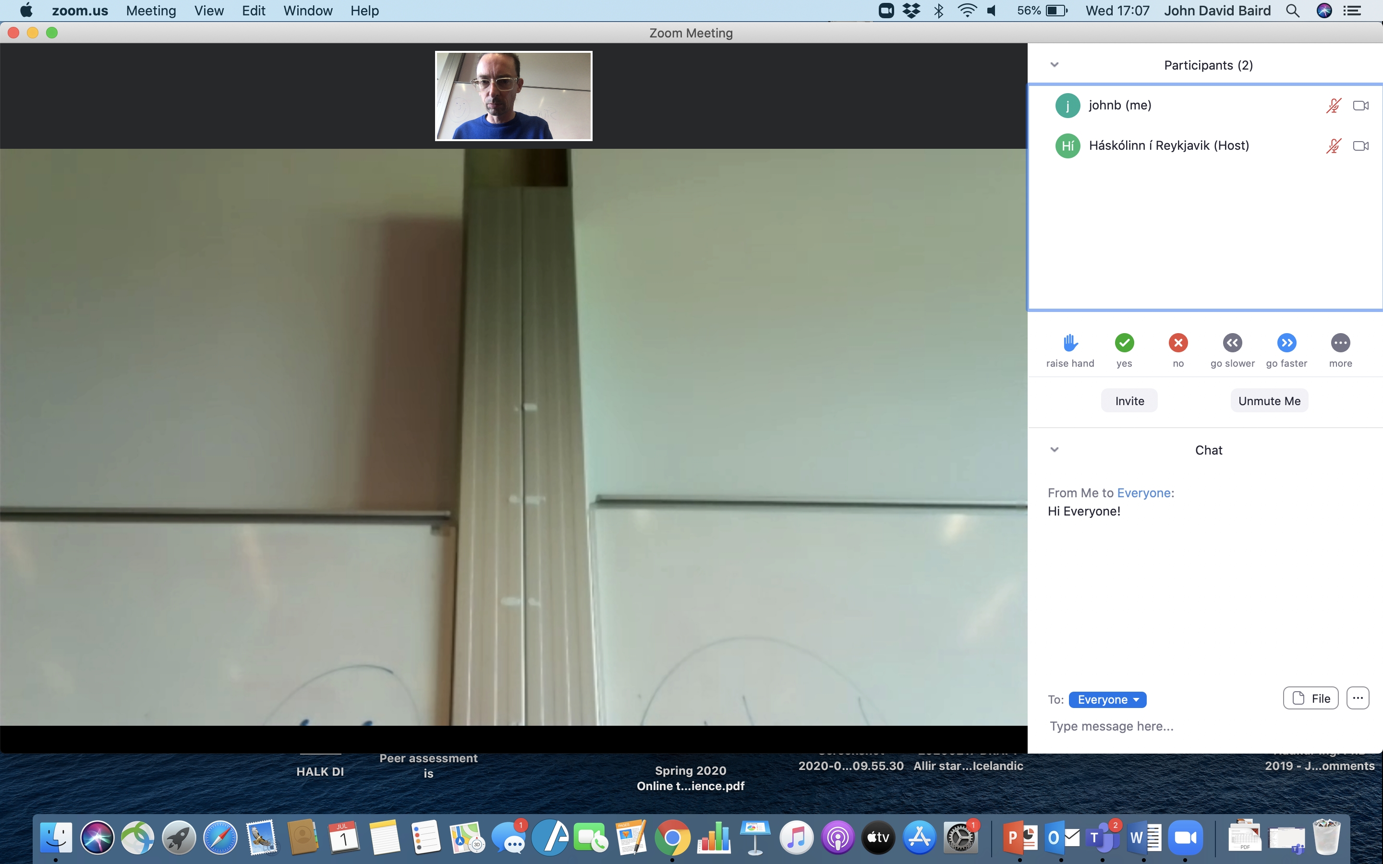
DEMO

Slide 5
One of the key findings of the Teaching Large Classes Project (TEDI, 2003) was that it is not the number of students in a class that is the critical component in lecture/large group teaching, but rather how the principles of effective teaching are implemented in that context.
“Perhaps the most basic [essential quality of a teacher] is…
…..realness or genuineness. When the [teacher] is a real person being what they are, entering into a relationship with the learner without presenting a front or facade, they are much more likely to be effective.” (Rogers, 1983, p.106 cited in Race, 2016)
RU Student Focus Group 2018
A good relationship with the teacher – students value easy access and personal attention
Clarity
Passion in teaching the material
RU Student Survey April 2020
Communication
Care

Slide 6
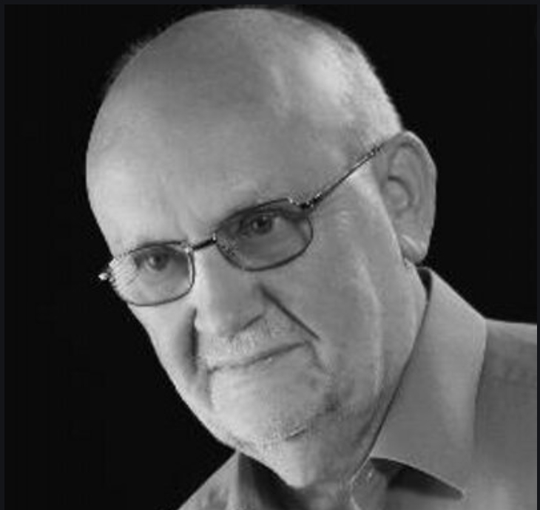
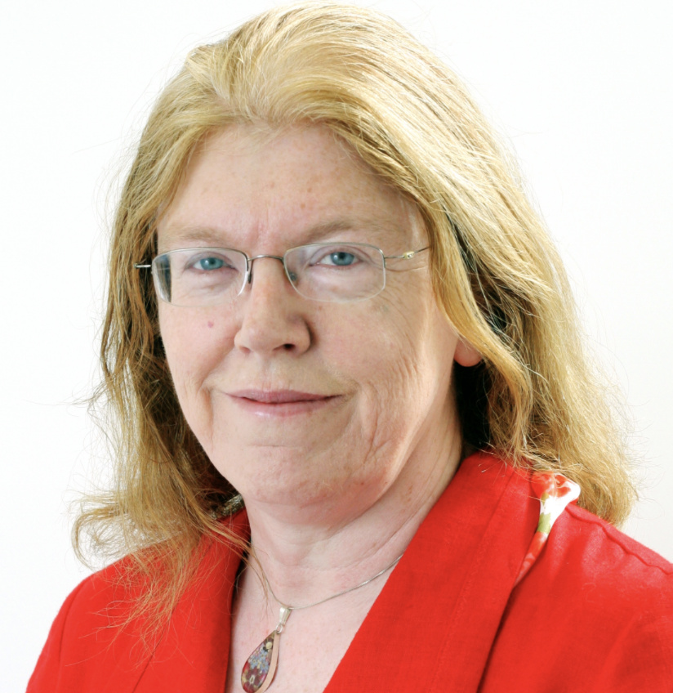
What the research says about why and how learning happens (2018)
7 Principles
Synthesised the findings of four syntheses of meta-analyses = several hundred thousand individual research papers
Chickering, & Gamson, (1987)
James, & Pollard, (2011)
Hattie (2015)
Pascarella, & Terenzini, (2005)
Dr. David Baume
Prof. Eileen Scanlon

Slide 7
A clear structure, framework, scaffolding surrounds, supports and informs learning
Clear intended learning outcomes
Clear course schedule
An appropriate set of learning activities
= Motivation
2. High standards are expected of learners, and are made explicit
Clear intended learning outcomes
Examples of work that achieves these outcomes
Opportunities to explore why good work is good and poor work is poor i.e. opportunities to explore and apply success criteria
= Motivation
3. Learners acknowledge and use their prior learning and their particular approaches to learning
Learning = getting from where we are to where we want to be
To do that we need to build on current knowledge and ways of working
It is hard to learn if we don´t know ourselves
It is hard to teach if we don´t know our learners

Slide 8
(4) Learning is an active process
(5) Learners spend lots of time on task, that is, doing relevant things and practising
Engagement = Motivation x Active Learning
(Barkley, 2017)
(6) Learning is undertaken at least in part as a collaborative activity - students and staff
Physical and/or cognitive activity
Asking the questions that make for productive thinking and learning
“That we learn through collaboration should not be a surprise, given the other principles. Principle 1, the need for a clear structure or framework, describes a prerequisite for effective collaboration rather than an automatic consequence of collaboration – we have probably all worked in poorly structured collaborations, which were less than effective. A constructive, well-motivated group is constantly striving to do better (Principle 2). In an effective collaboration, participants value and build on what everyone brings, as well as challenging and questioning as appropriate (Principle 3). Effective collaboration involves actually doing things together (Principles 4 and 5). Collaboration and conversation include receiving and using feedback on our thoughts (Principle 7).“
Relevant? Practice -> Theory
Time on task:
Sequenced appropriately
Structured to facilitate thinking about the issues, and to make relationships between what we are learning and what we know already
Constructive collaboration and feedback
Reference to clear, high expectations and standards

Slide 9
7. Learners receive and use feedback on their work
Feedback = any kind of usable response
USABLE?
Good + why + areas to continuing building on in future work
Less good + why + what might do differently in future work
Self-assessment & reflection
Peer-assessment
“It would be good to talk about [learning] more – about what we mean by learning, about the conditions for learning, about our individual preferences for learning, about what we know about how we learn and like to learn. These should be conversations, not lectures."

Slide 10
Bloom´s Taxonomy – Cognitive Domain (Bloom et al 1965, revised by Anderson et al, 2001
Are my Learning Outcomes:
❑ Meaningful i.e. are they aligned with the aims and objectives of the course
❑ Clear to the student & instructor
❑ Specific
❑ Observable
❑ Measurable/Assessable
❑ Followed by an action verb (avoid using verbs like ‘know’, ‘understand’, ‘appreciate’, ´be familiar with´, ´be aware of´)
❑ Representative of the range of levels of Bloom’s Taxonomy

Slide 11
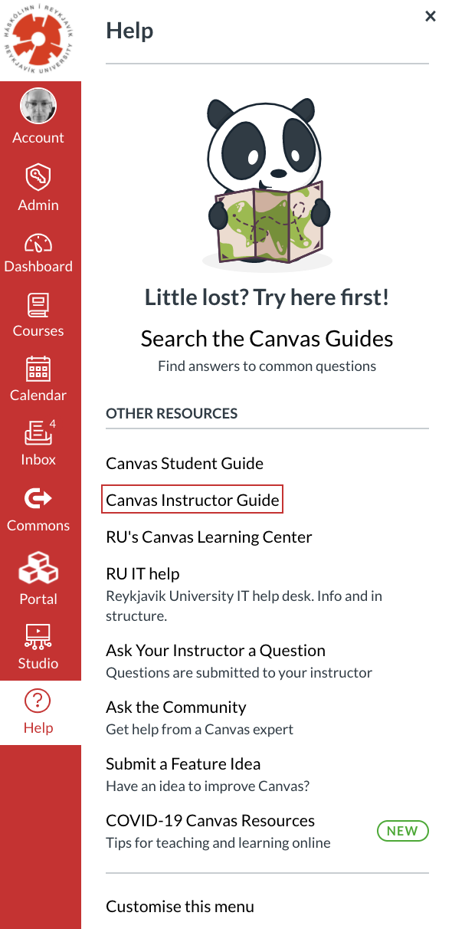
Lets you link to resources in different formats e.g. text, video, audio etc.
Efficient way of delivering course materials
Resources available at any time and from any location
Encouraging independent and active learning
Useful source of materials complementary to traditional one
Centralised communication and assessment
Time savings

Slide 12
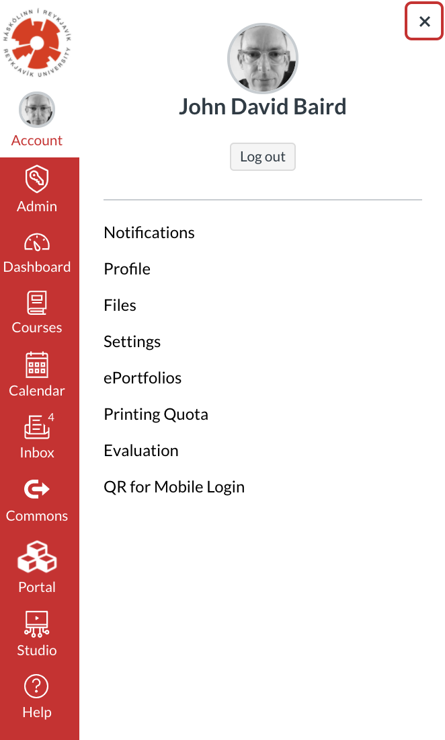
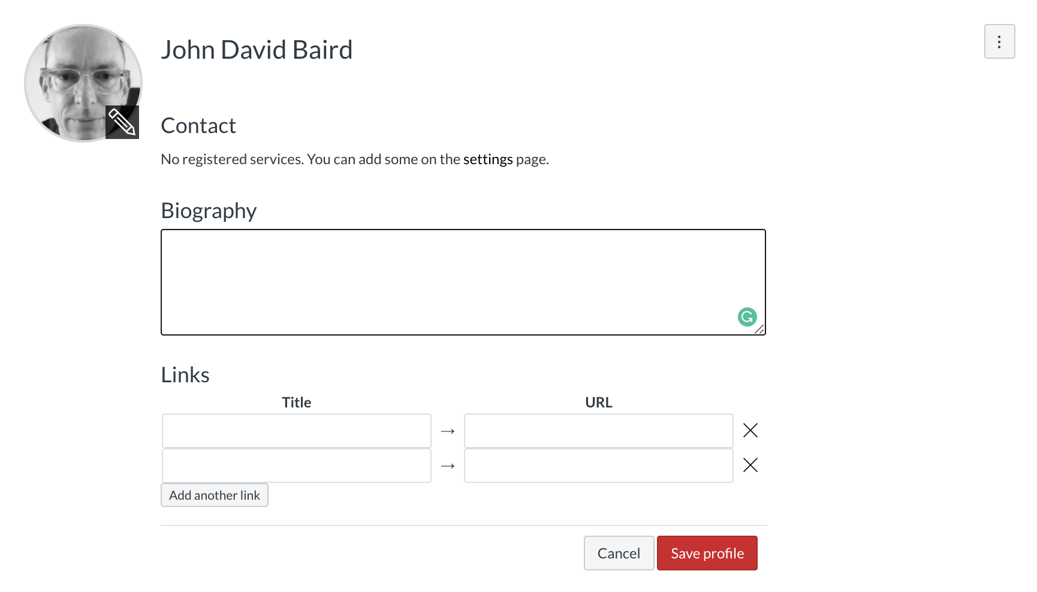
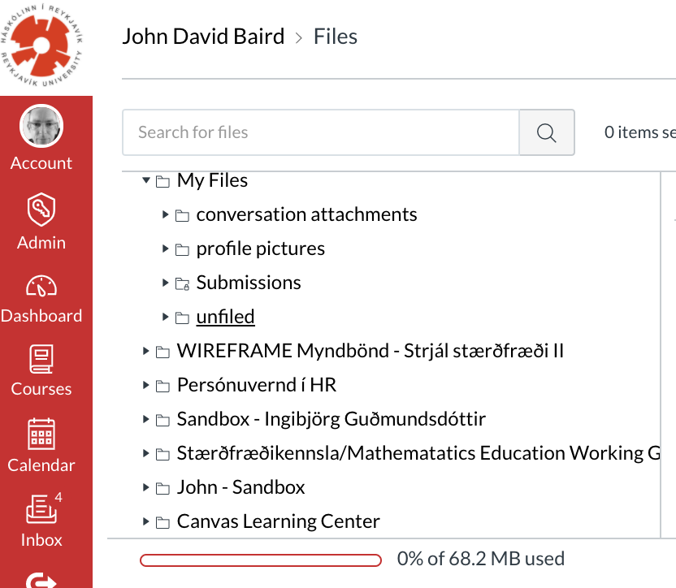
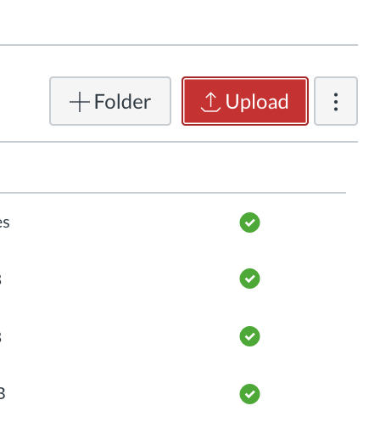
Canvas Guide - How do I set my Canvas notification preferences as an instructor?
Notifications (student) – Right Away
Announcement
Discussion
Discussion post
Groups – membership update
To Do
Upload a profile picture
Create a profile (image, bio, link x 1)

Slide 13
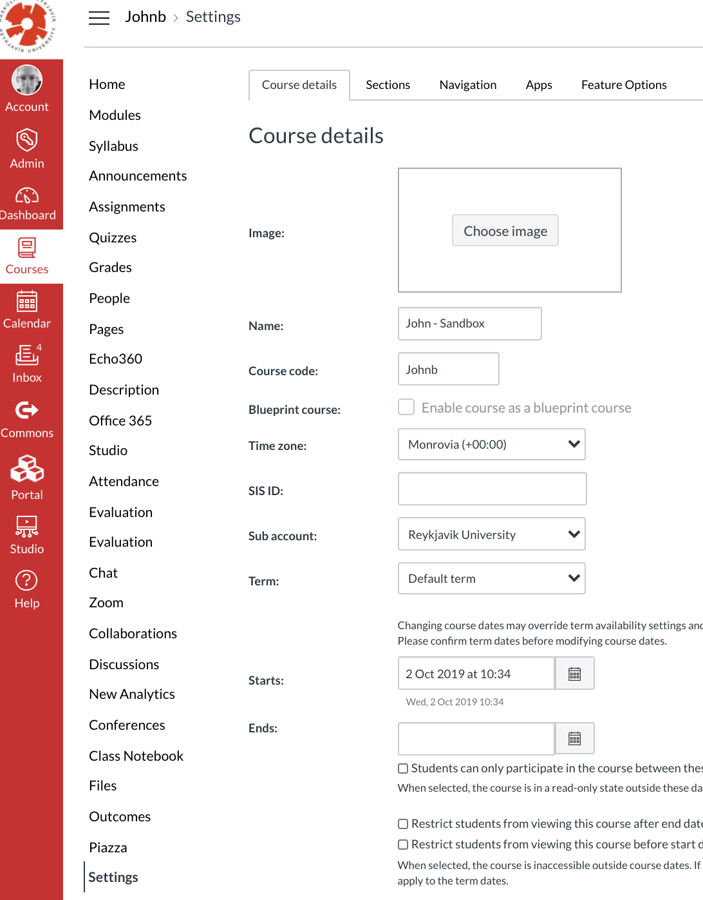
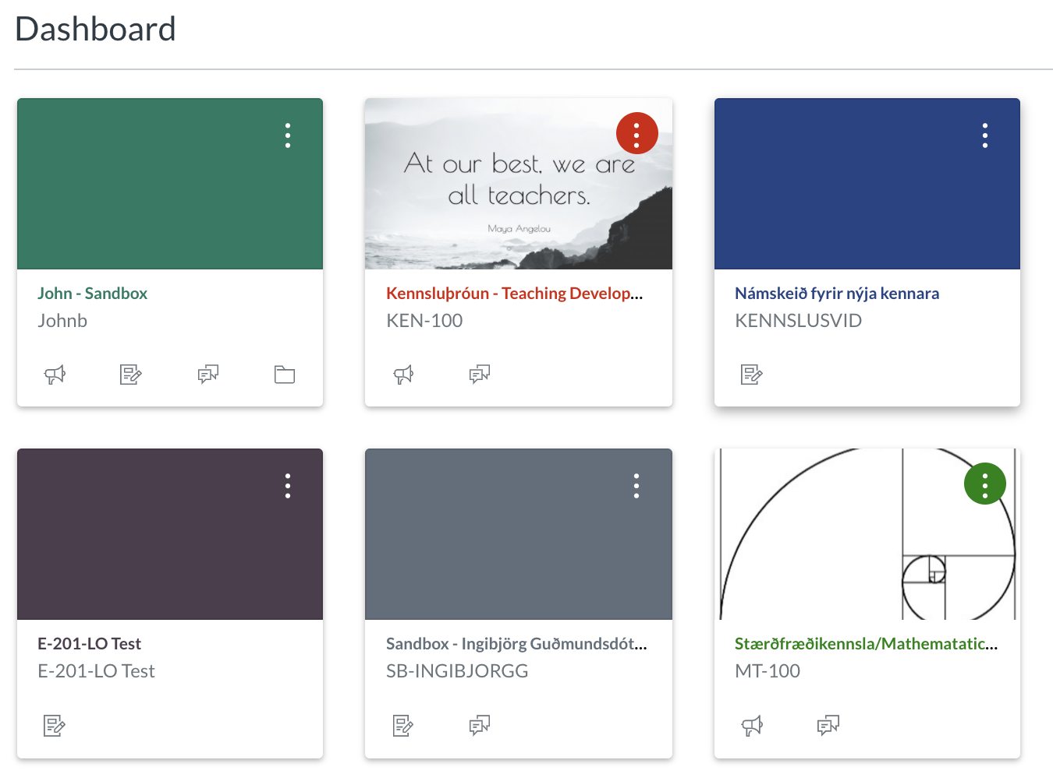
To Do
Add course tile

Slide 14
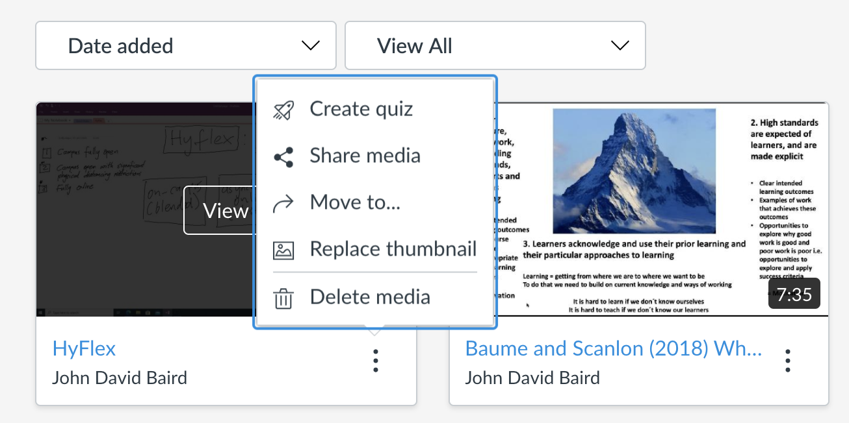
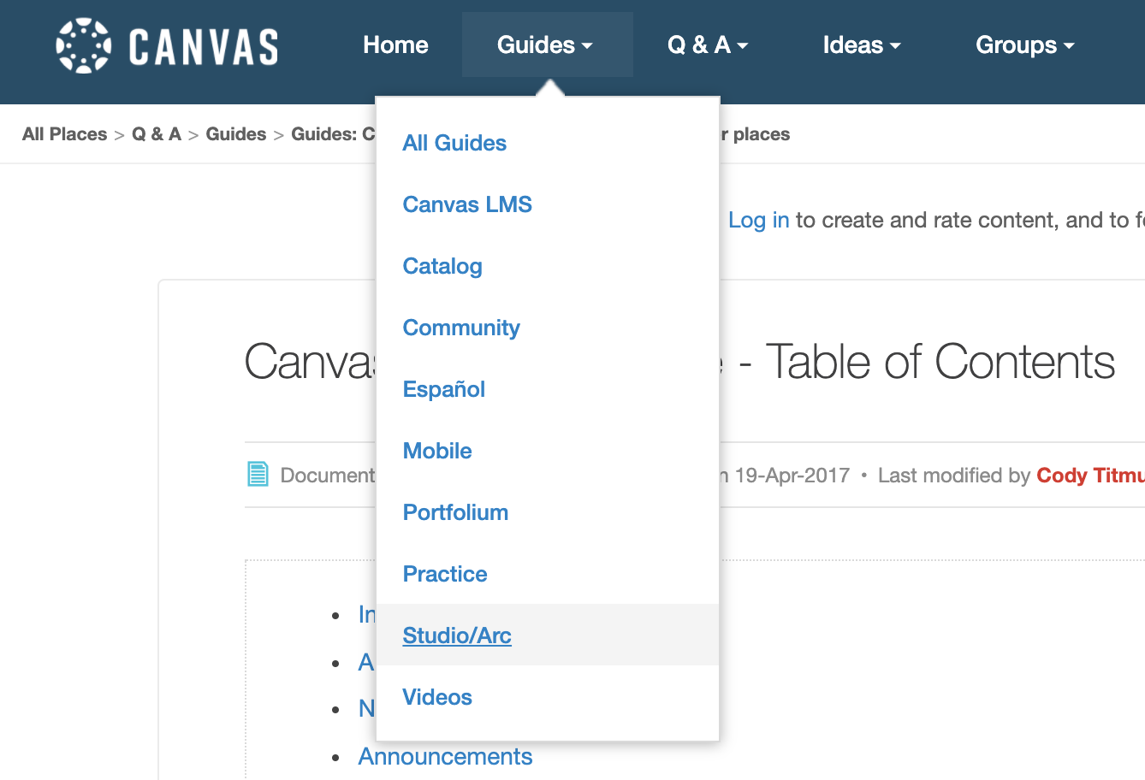
To Do
Record a video. Include this information:
My name is…
I´m from….
I´m passionate about (my subject area) because…
You should take this course because….
Record a screen capture of a website and explain why this resource is relevant to study in your subject area

Slide 15
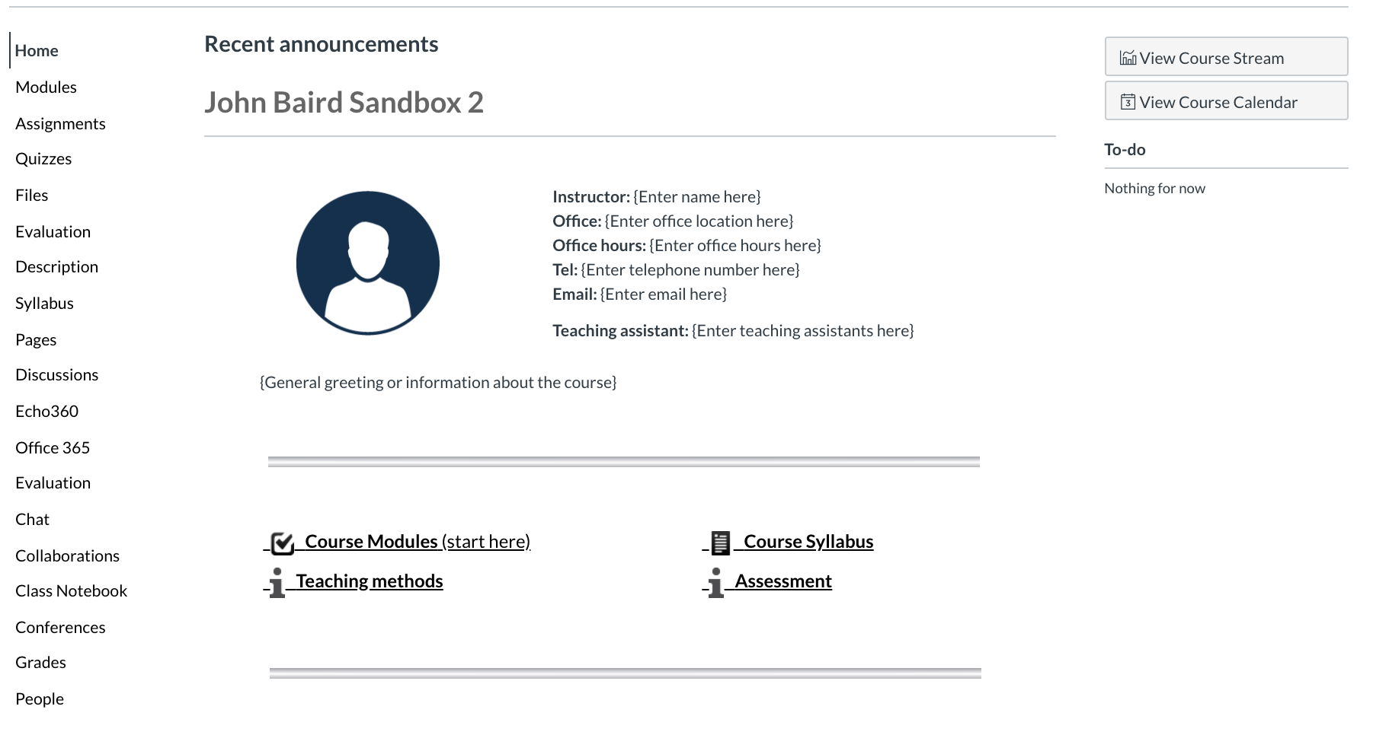

Slide 16
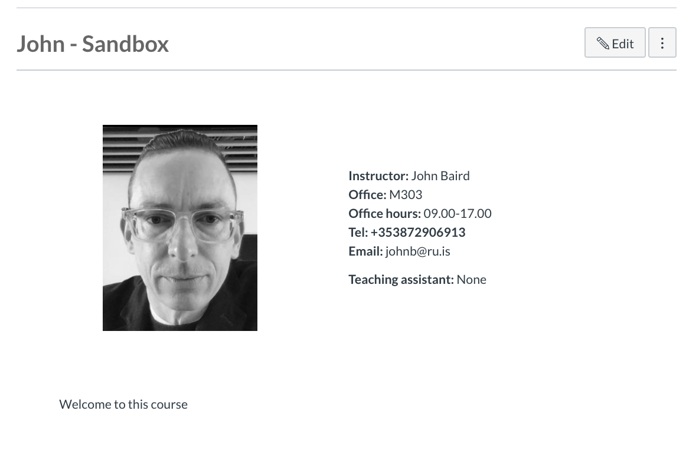
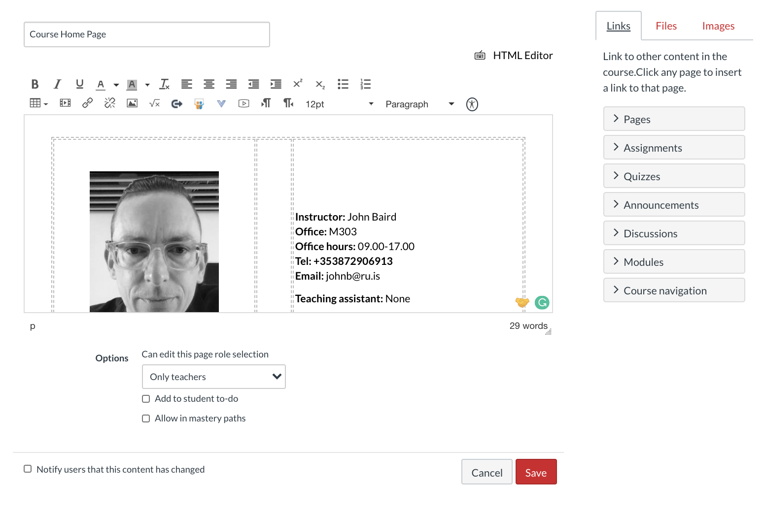
To Do
Edit your course page: Instructor, Office etc.
Embed a photo/image that captures the essence of the course
Embed the video you made

Slide 17
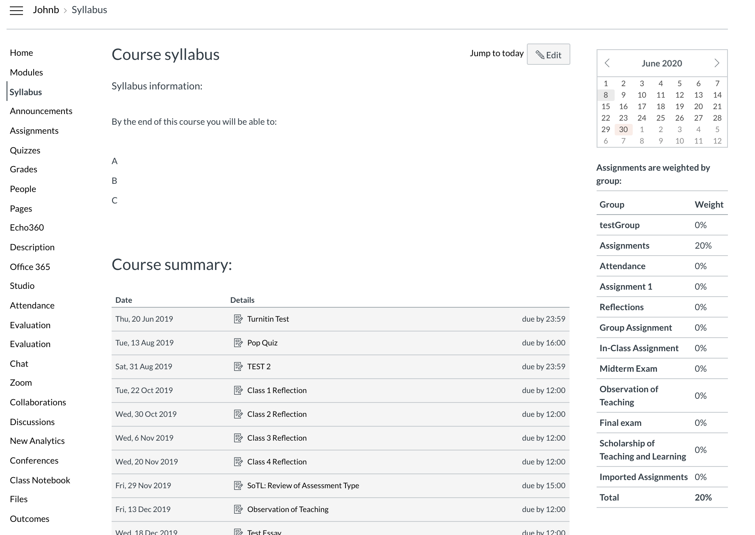
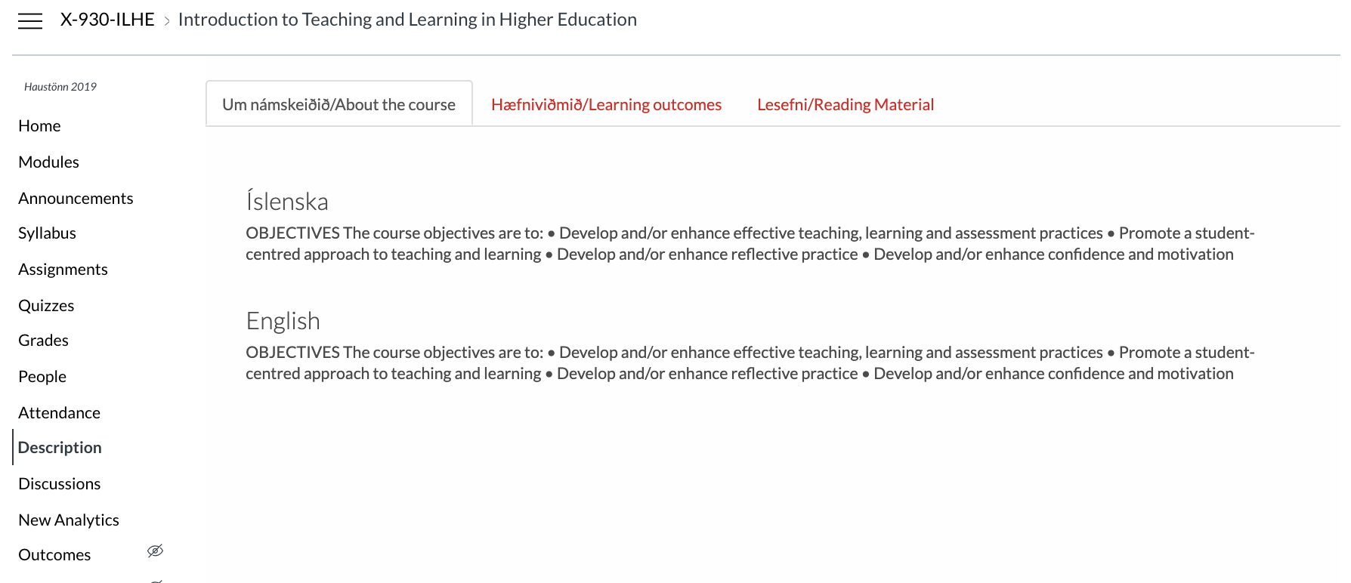
The functions of a syllabus
A reference guide used throughout the course by students (contact information, course policies, due dates, list of resources etc.)
Clearly outlines what a student must do in order to be successful in the course
An invitation to learning – a ´promise´ from you to them
Write in a clear, open, approachable style
Make visually appealing
Washington University in St. Louis, Constructing a Syllabus
How to introduce the syllabus?
Use a ´syllabus quiz´ e.g. which ILO is most important to you? Which of the assigned reading papers are you most/least looking forward to reading?
Ask students to identify info. in the syllabus in small groups and discuss what this means to them plus clarification questions
Washington University in St. Louis, Constructing a Syllabus

Slide 18
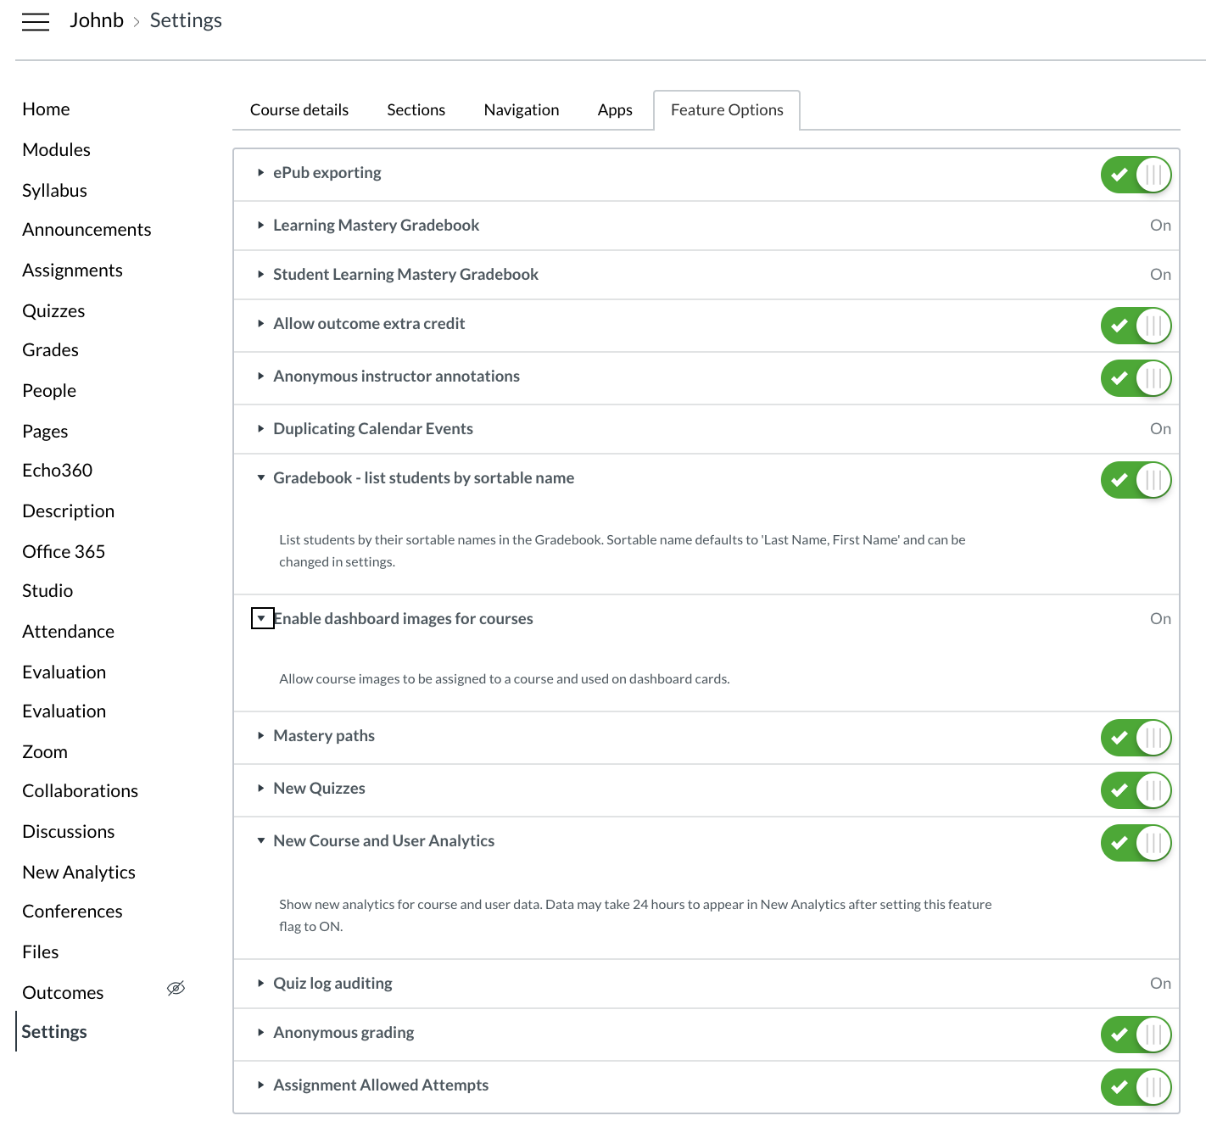

Slide 19
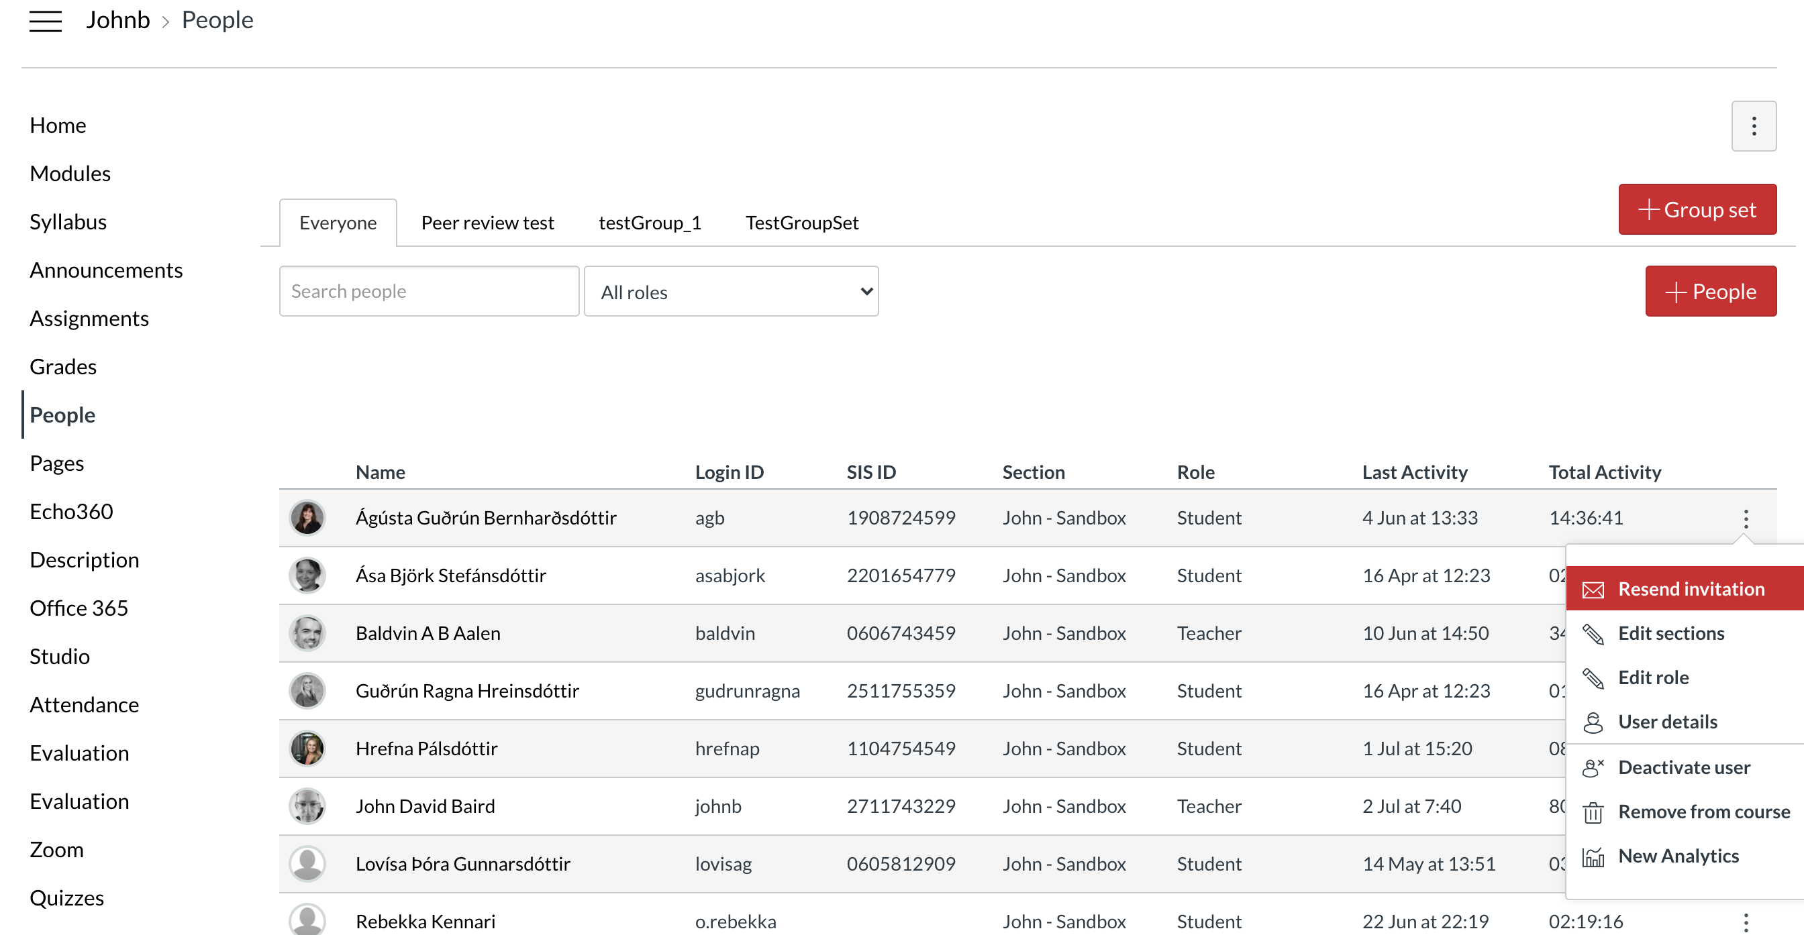
To Do
Create Group Set
Create Groups and assign students

Slide 20
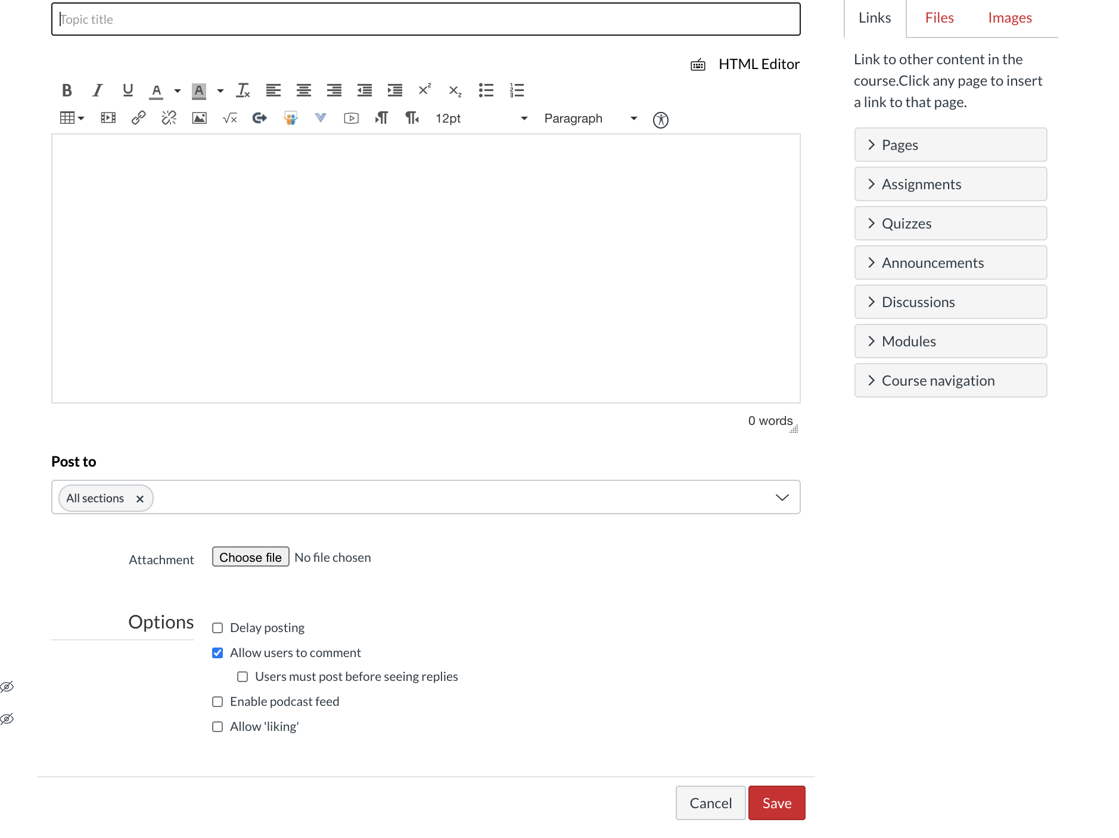
Announcements tab only visible once an announcement posted

Slide 21
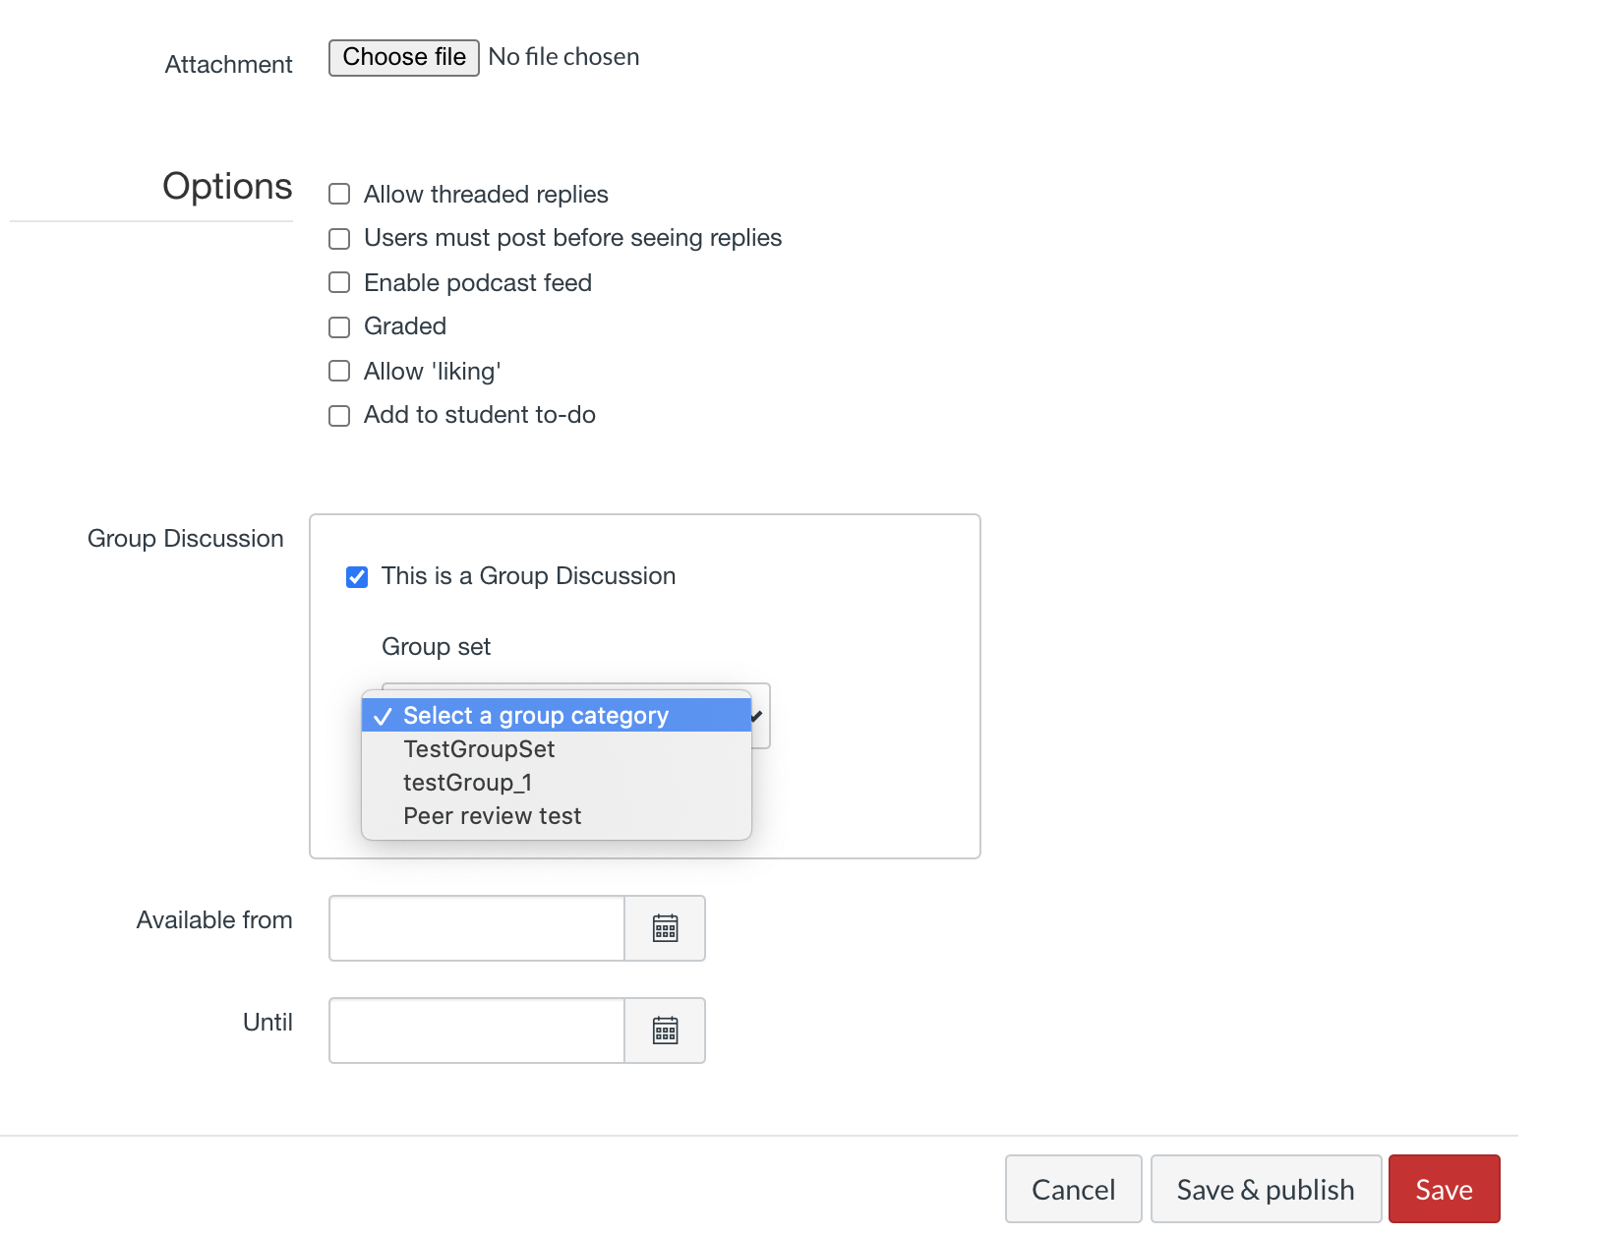
To Do
Create discussion thread

Slide 23
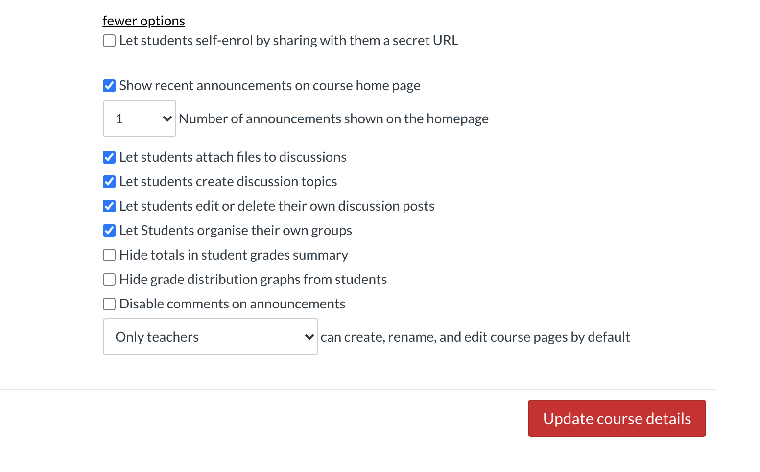

Slide 24
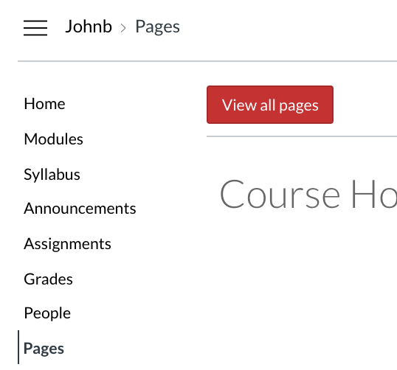
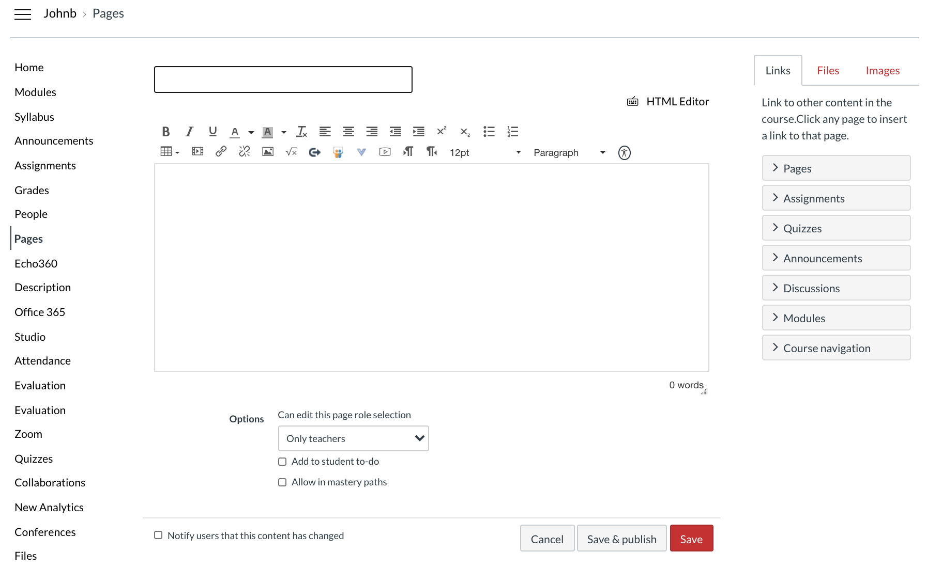
Create page
Text
Image
Link
Embedded file
Math equation
Studio video
External video

Slide 25
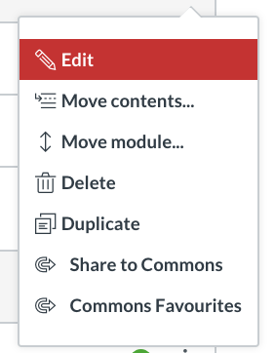
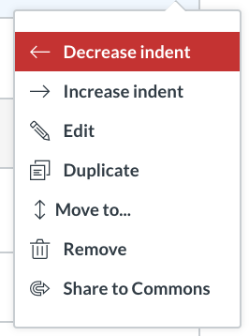
To Do
Build Module
Page
Discussion

Slide 26
Objectives of this session
Integrate an overview of the principles and practices of effective teaching with an overview of how Canvas can allow you to implement these pricniples and practices in your course
Provide opportunity to use this functionality of Canvas

Slide 27
References
Devlin, M. and Samarawickrema, G. 2010. ´The criteria of effective teaching in a changing higher education context´. Higher Education Research and Development; 29(2), pp.111-124. DOI: 10.1080/07294360903244398
Teaching and Educational Development Institute (2003). Teaching Large Classes Project 2001: Final Report. University of Queensland: Australia.
Race, P. (2016) How Students Really Learn ‘Ripples’ model of learning [Online]. Available at: https://phil-race.co.uk/most-popular-downloads/ (ripples10w-1.pptx ) (Accessed: 11 August 2019)
Barkley, E.F. (2017) Terms of Engagement: Understanding and Promoting Student Engagement in Today’s College Classroom in Matsushita, K (ed) Deep Active Learning, 99.33-57
Baume, D. and Scanlon, E. (2018). What the research says about how and why learning happens. In: R. Luckin, ed., Enhancing Learning and Teaching with Technology - What the Research Says, 1st ed. London: UCL IoE Press, pp.2-13.
Chickering, A. W., & Gamson, Z. F. (1987). ‘Seven principles for good practice in undergraduate education’, AAHE Bulletin, 39(7): 3–7
James, M., & Pollard, A. (2011). TLRP’s ten principles for effective pedagogy: Rationale, development, evidence, argument and impact. Research Papers in Education, 26(3), 275–328. doi:10.1080/02671522.2011.590007
Pascarella, E. T., & Terenzini, P. T. (2005). How college affects students Vol. 2: A Third decade of research (2nd ed.).
San Francisco, CA: Jossey-Bass Inc., U.S.

