Slide 1
DigiExam
Digital examination tool

Slide 2
Canvas
Start by logging into Canvas
Locate the relevant course on your Dashboard or via Courses
Select the course

Slide 3
Canvas to DigiExam
Locate DigiExam in the navigator on the left
Click the green button to run DigiExam
You should be signed in automaticlly
If you are not logged in automatically, do not create an account. Please contact IT – help@ru.is

Slide 4
Creating an exam
This is your view when you are logged in
Click the green button to create a new exam
Please remember:
all of your exams should be 100 points
the weight of each question has to be calculated accordingly by assigning points value per question

Slide 5
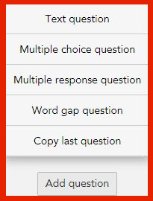
Exam settings
The following areas must be filled in
Title: course name
Subject: exam type (final exam, repeat exam etc.)
Public exam description: description and instructions to students
Click the image icon on the top left in the text area to insert image
Add question
Text question (select this for Essay submission)
Multiple choice question
Multiple response question
Word gap question
Copy last question

Slide 6
General exam settings
All exams are set to Score based grading
Student computer lockdown
On – students are locked in the DigiExam program. We strongly recommend that you do NOT lock for home exams as it creates difficulties if students accidentaly get locked out of the exam or lose wifi connection
Off – students can access data on the computer and internet. You have the option to prevent or allow students to copy and paste from other applications.
Time limit
Set the length of the the exam. The exam is automatically handed in at the end of the given time
Other options
Remote Proctoring – Used only in very rare cases and always consult Teaching Affairs beforehand
Anonymous exam
Locked question sequence (MEQ)

Slide 7
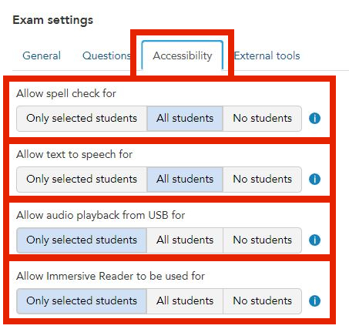
Optional exam settings
Questions
Randomize the order of questions
Randomize the order of alternatives
Accessibility
Allow spell check for
Only available in English and Swedish
Allow text to speech for
Allow audio playback from USB
Allow Immersive Reader
For students with special requirements, contact – help@ru.is for further information

Slide 8
Setup for an essay/Text Question
The following areas must be filled in
Question title
Question shown to the students
Max points
Optional areas
Click the image icon on the top left in the text area to insert image
Add media button – youtube, audio, webpage, PDF
All the media must be public and accessible for anyone e.g on OneDrive or Google Docs or the internet and not stored on a local hard drive
PDF can be shared from cloud storages but only as webpages must paste in weblink
Max length (words)
Your Notes
Are not visible to anyone except the teacher

Slide 9
Setup for multiple choice question
The following areas must be filled in
Question title
Question shown to the students
Correct answer
Max points
Optional areas
Click the image icon on the top left in the text area to insert image
Add media button – youtube, audio, webpage, PDF
All the media must be public and accessible for anyone and not stored on a local hard drive
PDF can be shared from cloud storages but only as webpages
Your Notes
Are not visible to anyone except the teacher

Slide 10
Setup for multiple response question
The following areas must be filled in
Question title
Question shown to the students
Correct answer
Max points
Grading options
Optional areas
Click the image icon on the top left in the text area to insert image
Add media button – youtube, audio, webpage, PDF
All the media must be public and accessible for anyone and not stored on a local hard drive
PDF can be shared from cloud storages but only as webpages
Your Notes
Are not visible to anyone except the teacher

Slide 11
Setup for word gap question
The following areas must be filled in
Question title
Question shown to the students
Correct answer
Max points
Grading options
Optional areas
Click the image icon on the top left in the text area to insert image
Add media button – youtube, audio, webpage, PDF
All the media must be public and accessible for anyone and not stored on a local hard drive
PDF can be shared from cloud storages but only as webpages
Your Notes
Are not visible to anyone except the teacher

Slide 12
Saving
Preview - gives you a print preview of the exam
Save
Save and close
If either of the save buttons are greyed out, some conditions have not been fulfilled e.g.
a question does not have a title,
a question does not have a points value attached (you cannot include a question worth zero/0 points)
Essay with 3 possible choices included in one question, or
the correct answer in a multiple choice/response question is not set

Slide 13
Save
Preview
Exams

Slide 14
Connecting Canvas and DigiExam – Create an assignment
Return to Canvas and select Assignments
Click + in Assignments

Slide 15
Create an assignment
In Type, chose External tool
Give the assignment a name
Manually set 100 points
Click More options

Slide 16
Create an assignment
Remind students to register for the exam in good time so valuable exam minutes are not wasted on registration and/or setup
Link the instructions
The link can be found on help.ru.is and also below
Refer to help@ru.is and IT service desk
To be able to take an exam in DigiExam, students need to register
How to register for exams taken in DigiExam

Slide 17
Connecting assignment to DigiExam
Under External Tool Options, click Find
Select DigiExam from the list

Slide 18
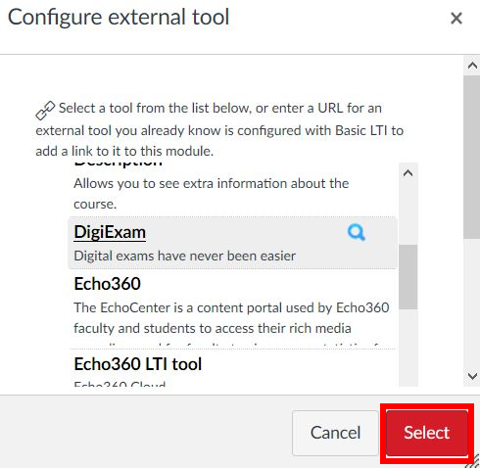
Connecting assignment to DigiExam
Every exam you have created will appear on this list
Select which exam to use
Confirm you have selected the correct exam and the Max points are 100
Click Select to confirm connection between Canvas and DigiExam

Slide 19
Saving & publishing an assignment
“Assign to“ is the only area that should be filled in
If the assignment is ready for publishing you can click Save & publish
Please note: Assignments should be published at least 48 hrs. before an exam
WARNING: If you change the exam after it is published, you need to reconnect the assignment with DigiExam, remove the older one and instruct students to register for the new version of the exam.
Please remember: hide the assignment grades in Canvas.

Slide 20
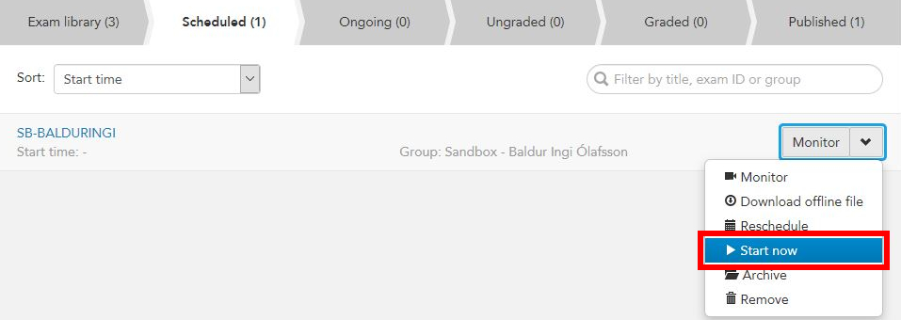
Starting an exam
The exam is started manually from DigiExam
Locate the assignment and click to open
Click Start exam in DigiExam
You are transferred to the DigiExam webpage
Click the dropdown arrow next to Monitor and select Start now
You can also click on the exam and view registered students. At the bottom of this page, you also have the option to start the exam

Slide 21
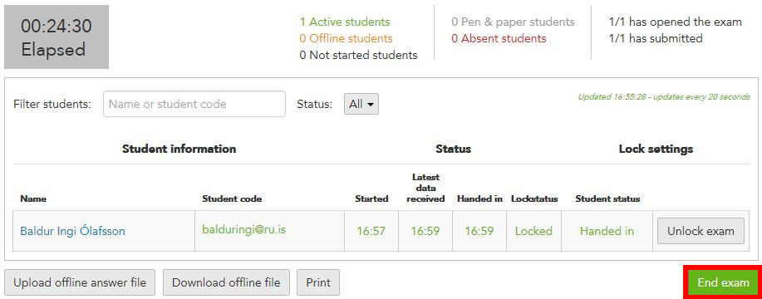
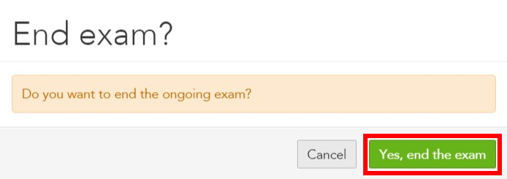
Monitoring and ending exam
IMPORTANT: You should download the offline exam file to a USB drive in case students get locked out by mistake or lose connection to the wifi. This is only an issue if you lock the program. If this happens, contact IT.
When you click the ongoing exam, you can view which students have turned in their exam and when. You can also view when they started the exam.
Click End exam to end
Confirm you want to end the exam by clicking the green button which says Yes, end the exam

Slide 22
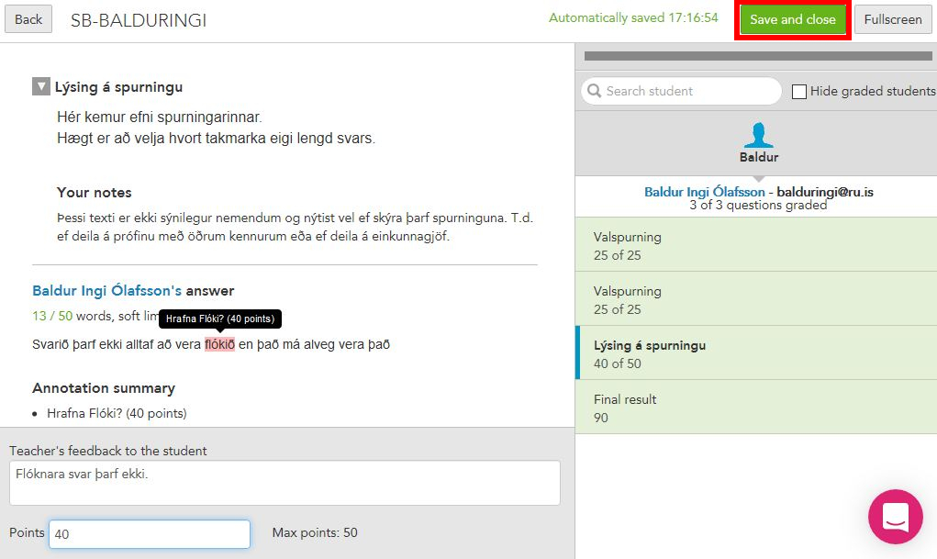
Grading
In the tab Ungraded, click Grade to start grading the exam
Click Continue grading to open the exam and begin grading
When you have finished grading, click Save and close
Even though the grading work may not be finished, you can take a break from grading and continue later

Slide 23
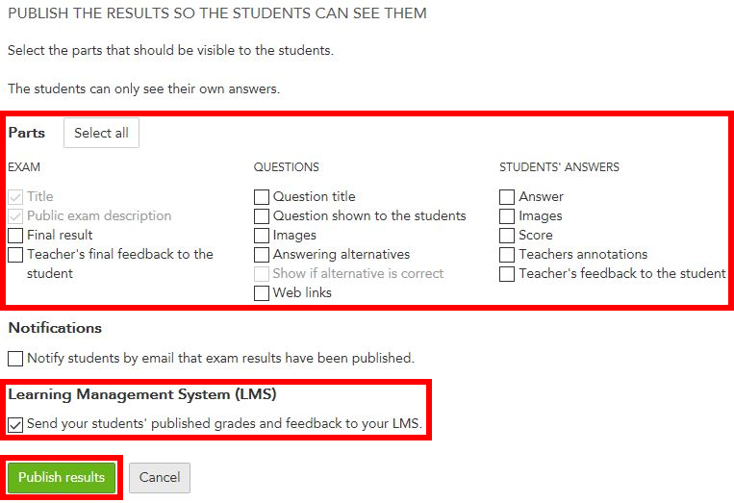
Publishing grades
Click Publish to export grades to Canvas
IMPORTANT: During final exams, uncheck all Parts of the exam
If parts are checked, students can see their grade, questions, answers and teachers feedback on the DigiExam webpage
This option is very useful when showing the exams to students as part of the feedback process
To export grades from DigiExam to Canvas you MUST check: Send your students' published grades and feedback to your LMS
Click Publish results to export grades

